Slide 1
DIGITAL ETHICS
- DATA PRIVACY AND PROTECTION
- OPEN DATA OF PUBLIC INFORMATION
- INTELLECTUAL PROPERTY AND COPYRIGHT
- PLAGIARISM
- DIGITAL COMMERCE UNDER COVID-19

Slide 2
THE PERSONAL DATA (PRIVACY) ORDINANCE (個人資料(私隱)條例)
Aim: protect the privacy interests of individuals in relation to personal data.
  A law to protect a citizen’s privacy when his or her personal data is collected and used by an institution for a particular purpose.
  commenced operation in December 1996.
people/companies violates the PDPO;
  Commissioner of PCPD can issue personal data security breach notification for individual/company violating the PDPO, to enforce improvement.
data privacy

Slide 3
THE SIX PRINCIPLES OF PDPO
 | Principle | Specific tasks
Principle #1 | deals with the collection of personal data | should be lawful and fair, adequate and not excessive
Principle #2 | deals with the retention of personal data | should not keep the data longer than necessary & accuracy
Principle #3 | deals with the proper use of personal data | should get consent and match with purpose
Principle #4 | deals with the security of personal data | should ensure confidentiality, integrity and availability of data
Principle #5 | deals with openness about the personal data | should formulates and discloses polices and practices
Principle #6 | deals with the access & correction to personal data | should allow and provide access and make correction to data
https://www.pcpd.org.hk/english/data_privacy_law/6_data_protection_principles/principles.html
data privacy
Notes:
https://www.pcpd.org.hk/english/data_privacy_law/6_data_protection_principles/principles.html

Slide 4
PRINCIPLE 1 - COLLECTION
Purpose and manner of collection of personal data
  collecting personal data must be lawful and fair.
    One should collect only what is needed for the intended purpose.
  amount of data collected is adequate but not excessive.
    One should not collect more than it is needed.
Violation Examples:
  employer secretly monitors his/her staff by security cameras in shop floors and staff pantry, without giving any notice/warning. (unlawful), and (excessive)
  Asking people’s HKID number while doing a street survey on consumers’ shopping habits. (excessive)
data privacy
Notes:
(supplementary information - optional)

Slide 5
PRINCIPLE 2 - RETENTION
Accuracy and duration of retention of personal data
Personal data are kept accurate for the purpose of being used
  If the data is not accurate, then it should be corrected or erased.
  If the inaccurate data has already been disclosed to a third party, the third party must be informed so as to make proper corrections. (data integrity and availability)
Compliance Example:
  When someone borrow money from a bank, he/she may have signed and authorized the bank to send the phone number or address to a collection agency. If the data is wrong, then the bank must inform the collection agency (3rd party) so that the data can be corrected.
data privacy
Notes:
(supplementary information - optional)

Slide 6
PRINCIPLE 2 - RETENTION
Accuracy and duration of retention of personal data
Personal data shall not be kept longer than necessary
Compliance Examples:
  If I organize a on-line game competition and collect personal data from participants, then their personal data should be erased as soon as the competition is completely finished and all prizes given out properly.
data privacy
Notes:
(supplementary information - optional)

Slide 7
PRINCIPLE 3 – PROPER USE
Personal data shall not, be used for any purpose other than the purpose for which the data were to be used at the time of collection without the consent of the data subject.
Violation Examples:
  If a company organize a lucky draw, and obtain the participants’ names and addresses. The company use this information to send out marketing promotional material. (these data should not be used for any other purposes other than lucky draw, unless the participants are informed beforehand and agree to it.)
data privacy
Notes:
(supplementary information - optional)

Slide 8
PRINCIPLE 4 - SECURITY
Security of personal data
A data user must take all practicable steps to make sure that personal data held are protected against unauthorized or accidental access, processing, erasure or other use.
Compliance examples:
  The room in which the data is stored should be properly locked and access to the room under good control.
  The security of the data includes not only the storage but also during the transmission of the data.
data privacy
Notes:
(supplementary information - optional)

Slide 9
PRINCIPLE 5 - OPENNESS
This provides for openness by data users about the kinds of personal data they hold and the main purposes for which personal data are used.
  Data user should provides policy for how information to be generally available
  Data subject can ask data user to disclose its personal data policies and practices
Compliance examples:
  a public website should have a suitable personal data policies with practices, there should be a link to display the policy of personal data and practices that compiled with the PDPO.
data privacy
Notes:
(supplementary information - optional)

Slide 10
PRINCIPLE 6 – ACCESS AND CORRECTION
Access and correction to personal data
  A data subject shall be entitled to know whether a data user holds his or her own personal data.
As a system administrator (data user) of a website, he should reply the request of user (i.e. data subject) to access his/her own personal data
  Compliance examples:
    A mobile phone user can ask the company to list out the details of telephone transaction. The company cannot refuse his access of user’s personal data (i.e. transactions of his mobile phone)
data privacy
Notes:
(supplementary information - optional)

Slide 11
PRINCIPLE 6
Access and correction to personal data
  A data subject can ask the data user to correct the data if the data is found to be incorrect.
  Data user should correct it when it can be corrected; or stop using it if it cannot be corrected.
Compliance Examples:
  A person obtained a loan, and later found that there are errors in his credit report from credit reference agency (CRA). He can ask the CRA to amend and notify the bank with inaccurate data deleted within a period of time. Both the CRA and the bank need to observe the notification requirement.
data privacy
Notes:
(supplementary information - optional)

Slide 12

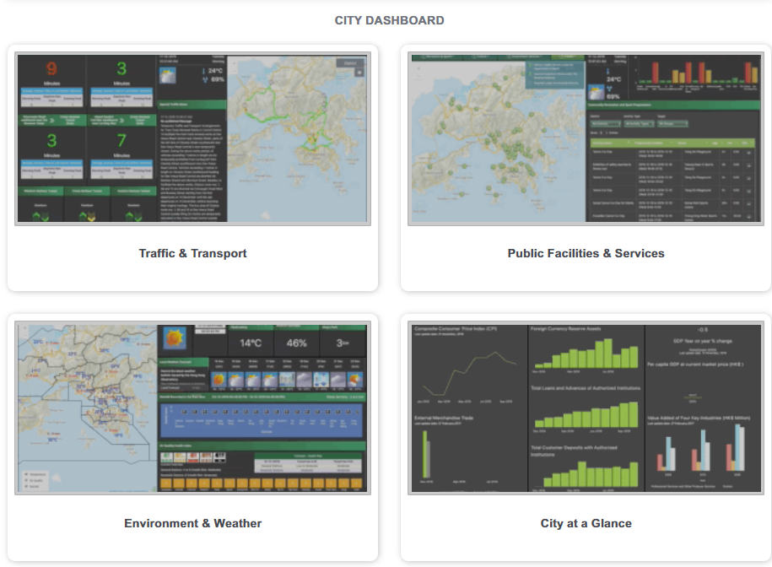
OPEN DATA OF PUBLIC INFORMATION
https://data.gov.hk (資料一線通)
A Public Sector Information (PSI) portal that lets you find various city data, find facts about your neighborhood, and lets you download geospatial data about the city, all of which can be used for commercial app development, personal analysis or academic study freely
Various of Datasets provided
Public Information
Notes:
https://data.gov.hk

Slide 13
INTELLECTUAL PROPERTY RIGHTS IN HK
Intellectual property rights (IPR) is a term that describes a range of intangible property rights
IPR also aim to protect freedom of expression
  In line with Article 139 of Basic Law of HKSAR
    The Government of the HKSAR shall, on its own, formulate policies on science and technology and protect by law achievements in scientific and technological research, patents, discoveries and inventions.
In Hong Kong, there are four major types of IPR:
  Trademarks (商標)
  Patents (專利)
  Registered design (外觀設計)
  Copyright (版權)
IPR

Slide 14




REGISTERED TRADEMARKS
Registered trademarks are registered in the Hong Kong Trademarks Registry
  protected by the Trademark Ordinance in Hong Kong (Cap. 559).
  registration in other places such as the PRC Trademarks Office does not automatically get protection in Hong Kong and vice versa.
  There are many examples of court cases involving trademarks disputes (i.e. iPad, Air-Jordan, etc.)
IPR
Notes:
(supplementary information - optional)

Slide 15
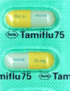
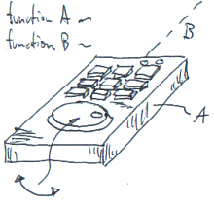
PATENT
It is protected by the Patents Ordinance in Hong Kong (Cap. 514).
In HK, patents are administrated by the Intellectual Property Department, and records are stored in Patents Registry
Two types of patent
  Short term: Protect inventions with short commercial viability is renewable after four years from filing, for a maximum of 8 years.
  Standard Invention under standard patents is renewable annually for a maximum of 20 years.
Invention with patent becomes a public domain when its patent expired without renewal
IPR
Notes:
(supplementary information - optional)

Slide 16


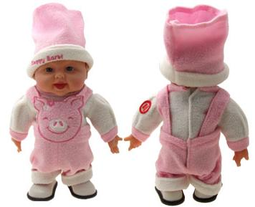
REGISTERED DESIGN
Designs for a wide range of products registered for the protection of their appearance.
  Protected by the Registered Designs Ordinance in Hong Kong (Cap. 522).
Examples:
  Appearance of jewelry and watches
  Computers layout of computers and telephones
  Design of garment and tools
IPR
Notes:
(supplementary information - optional)

Slide 17
COPYRIGHT
Copyright generally refers to the right given to the owner of an original work.
It is also related to the Basic Law Article 140 of the HKSAR
  The Government of HKSAR shall, on its own, formulate policies on culture and protect by law the achievements and the lawful rights and interests of authors in their literary and artistic creation
Examples:
  Literary works such as books and computer software
  Musical works such as musical compositions
  Dramatic works such as plays
  Artistic works such as drawings, paintings and sculptures
  Audio/Video recordings, photographs, films, TV broadcasts
  The typographical arrangement of published editions of literary, dramatic or musical works, as well as performers' performances
IPR
Notes:
(supplementary information - optional)

Slide 18
COPYRIGHT (2)
Copyright is enforced through the Copyright Ordinance in Hong Kong. (Cap. 528)
  It is an automatic right. It arises when a work is created.
  It is not necessary to register a copyright in Hong Kong
  Works of authors from any place in the world or works first published anywhere in the world also qualify for copyright protection in Hong Kong.
  Copyright does not require the work to have an aesthetic value nor to be clever nor very creative.
  Copyright works made available on the Internet environment are also protected.
The general rule is that copyright lasts until 50 years after the creator of the work dies. However, there are minor variations to this depending on the type of works.
IPR
Notes:
(supplementary information - optional)

Slide 19
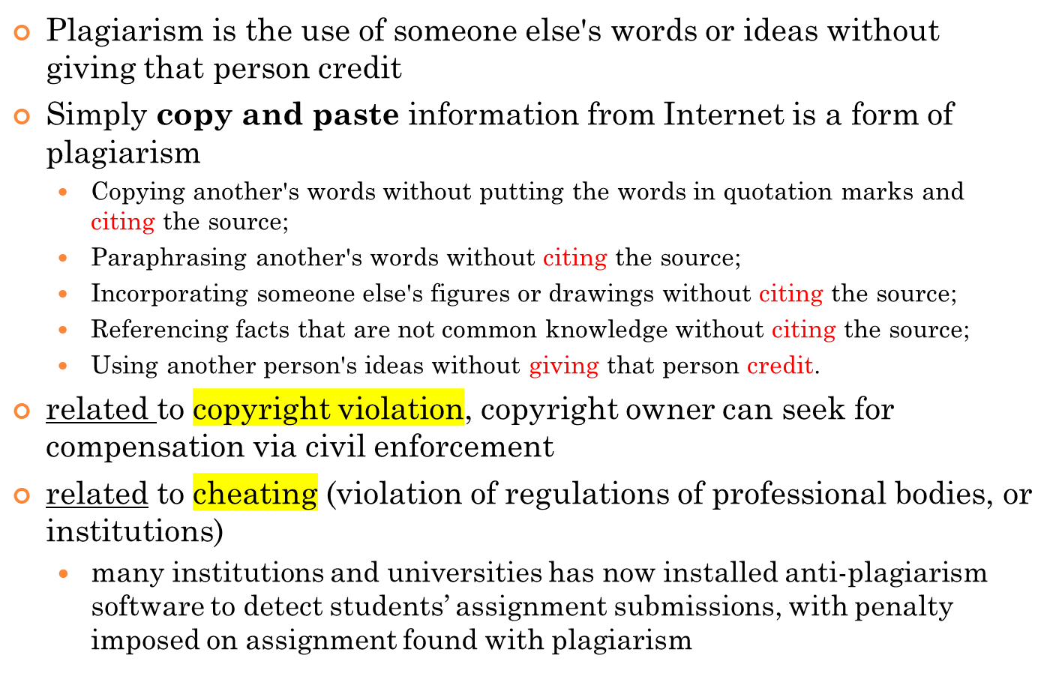
PLAGIARISM
IPR

Slide 20
PLAGIARISM (2)
To avoid allegation of plagiarism, use citation and reference properly
  When use someone else’s work in any way, you must quote its author(s) and source.
  Citation: you need to cite sources appropriately within text of the paper/report/dissertation
  Reference: you need to provide details at the end of the paper/report/dissertation
  There are difference referencing systems
  (e.g. Numbered Reference (IEEE standard), APA and Harvard Reference).
Bibliography – a similar but different concept; list of books/materials/journals used in the document, without the need of citation within text
External link – documents may also contain links to other web pages. Some external links are welcome but authors need to be careful, as it may lead to external link spamming.
IPR

Slide 21
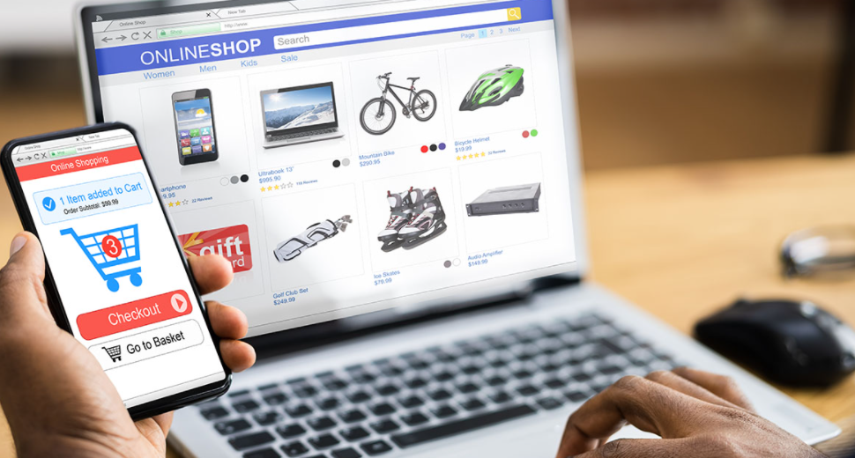
HOW COVID-19 TRIGGERED THE DIGITAL COMMERCE
COVID-19 has led to a surge in e-commerce and accelerated digital transformation.
As lockdowns became the new normal, businesses and consumers increasingly “went digital”, providing and purchasing more goods and services online, raising e-commerce’s share of global retail trade from 14% in 2019 to about 17% in 2020.
Digital Commerce
Notes:
https://unctad.org/news/how-covid-19-triggered-digital-and-e-commerce-turning-point

Slide 22
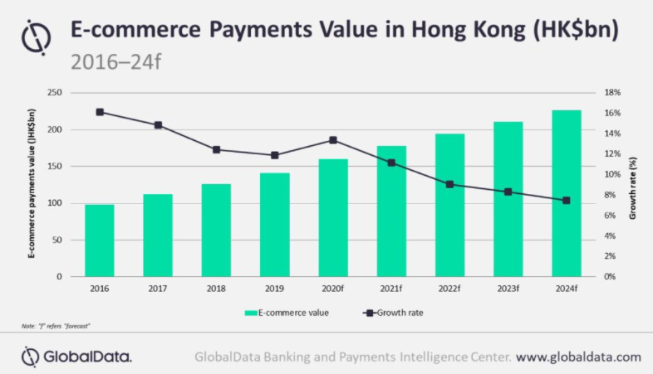
HOW COVID-19 TRIGGERED THE DIGITAL COMMERCE
While the pandemic led to a decline in consumer spending, this is being partially offset by rise in online spending, as wary consumers continue to stay at home and use online channels to purchase goods. The pandemic has resulted in change in consumer buying behavior too as they are avoiding visiting shopping centers and choosing online platforms for their day-to-day purchases.
Digital Commerce
Notes:
https://www.globaldata.com/covid-19-makes-e-commerce-even-more-preferred-among-shoppers-in-hong-kong-says-globaldata/

Slide 23

SELF-STUDY ONLINE QUIZ
Digital Commerce
Notes:
Complete the Self-study online quiz

